Slide 1


COMMUNICATION DESIGN
Project
Presentation

Slide 2

Table of
CONTENTS
01
02
03
INTRODUCTION
DESIGN REQUIRMENTS
DESIGN METHODOLOGY
04
05
TECHNIQUES USED
PERFOEMANCE FIGURES

Slide 3

DESIGN REQUIREMENTS
SUCCESSFUL TRANSMISSION AND RECEPTION OF A BIT STREAM, AN IMAGE, AND REAL TIME VOICE STREAM
MADE FOR
WITH jamming
WITHOUT jamming
CHANGING distances
frequency offset between transmitter and the receiver
multipath propogation corection

Slide 4

DESIGN
methodology

Slide 5

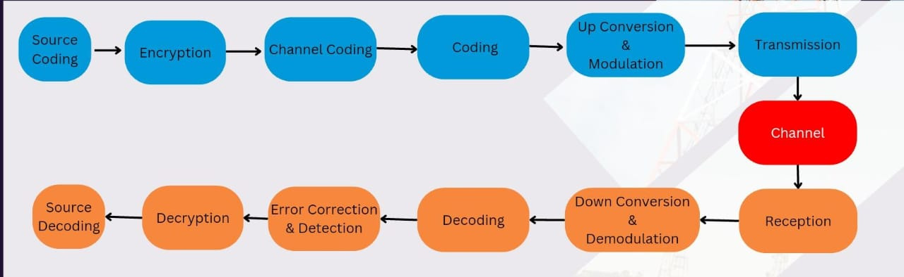
OUR APPROACH...
1. IDENTIFYING THE MAIN BLOCKS OF A COMMUNICATION SYSTEM

Slide 6

OUR APPROACH...
2. Implementing the system by flowgraphs
GNU RADIO FLOW GRAPHS
TRANSMITTER
RECIEVER
CHANNEL

Slide 7

APPROCHING TO MAKE A COMMUNICATION SYSTEM
OUR APPROACH...
3. Designing a system that can transmitt data through a
channel using SDR’s
Using blade rf/RTLSDR and replacing channel block with bladeRf/RTLSDR system blocks and change the parameters so one can be the transmitter and the other can be the receiver

Slide 8
OUR APPROACH...
4. Adding the nessasary parameters for it to be able to transmitt and receive
Text file
Image
Audio file
By adding nessasary parameters for overcome Jamming, Frequancy offset , Variable distance

Slide 9
OUR APPROACH...
Further improvements need to be made to overcome
Channel Estimation
Adaptive Transmission
Noise Cancellation

Slide 10
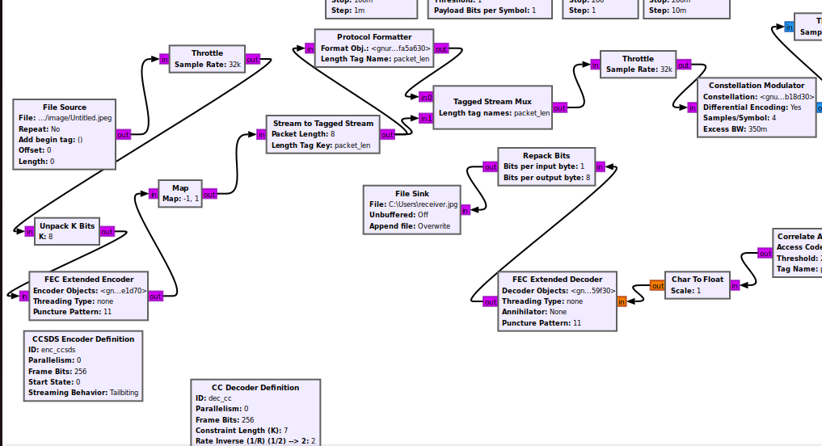
TRANSMISSION FLOW GRAPH

Slide 11
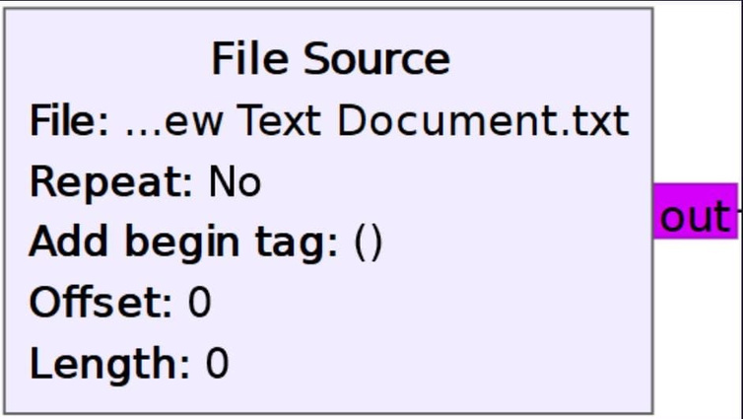
File Sourse
In GNU Radio, a file source block is used to read data from a file and input it into the signal processing flowgraph. This block allows to work with pre-recorded signals or data saved in a file, enabling offline analysis and processing. We can specify the file path, format, and other parameters to read the data from the file source block.

Slide 12

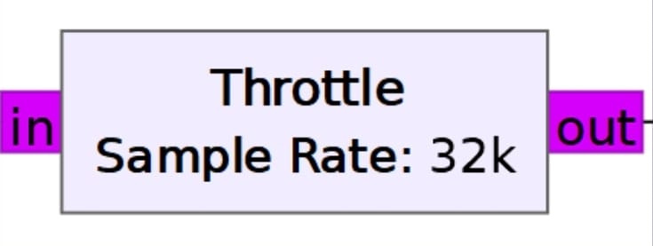
Throttle
The throttle block in GNU Radio regulates the flow of data through the signal processing flowgraph, preventing excessive processing speeds and ensuring a controlled and stable data flow.

Slide 13
Making data packets for transmitting
The packetizing block in GNU Radio organizes continuous data into packets or frame. This facilitates efficient handling and processing of data in packet-oriented communication scenarios.

Slide 14
Modulation in QPSK
The QPSK modulation block in GNU Radio transforms binary data into Quadrature Phase Shift Keying (QPSK) symbols. QPSK is a modulation scheme that encodes two bits of information per symbol for 4 symblos by varying the phase of the transmitted signal.

Slide 15
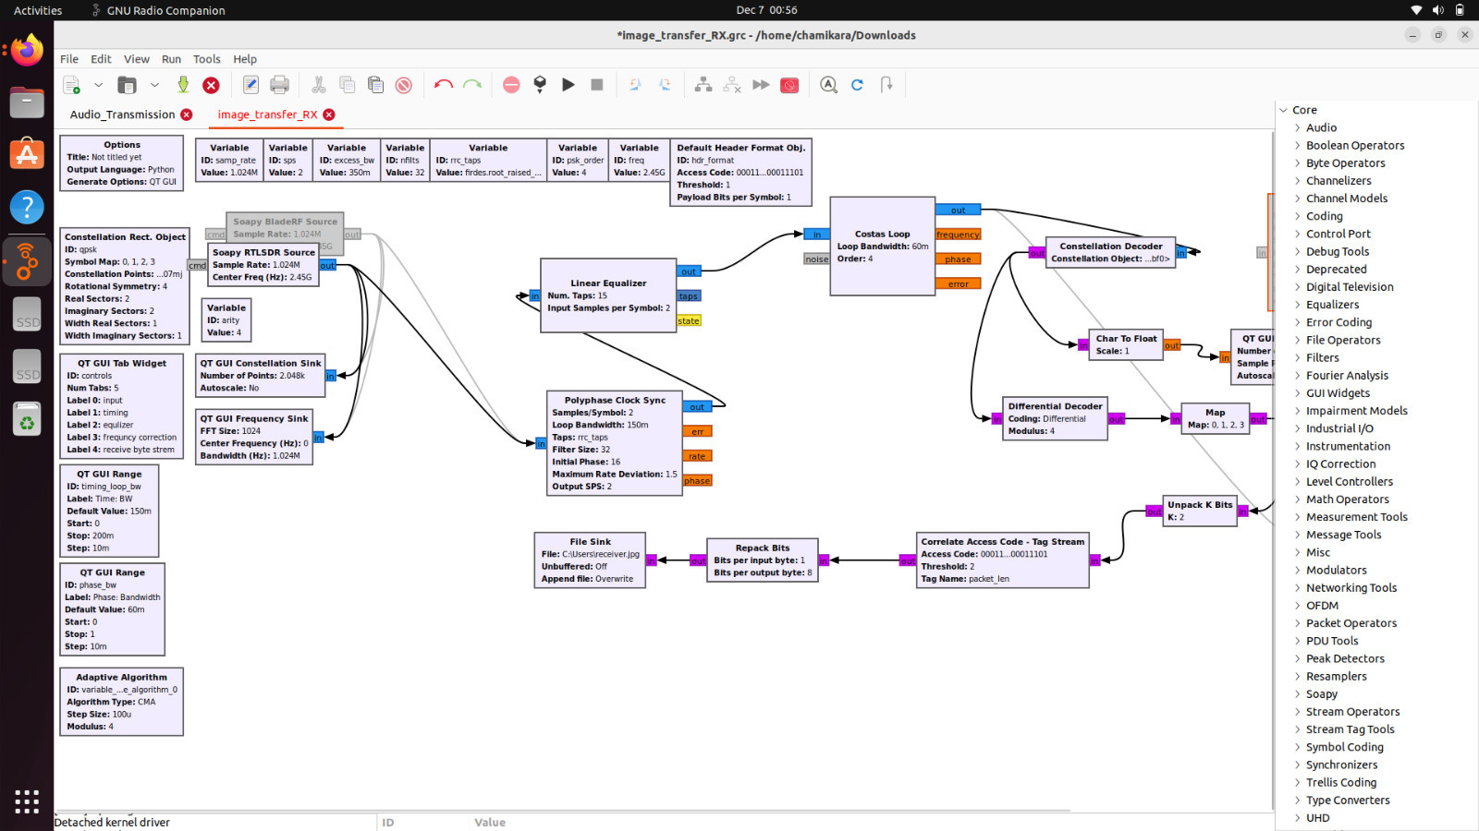
Receiving flow graph

Slide 16
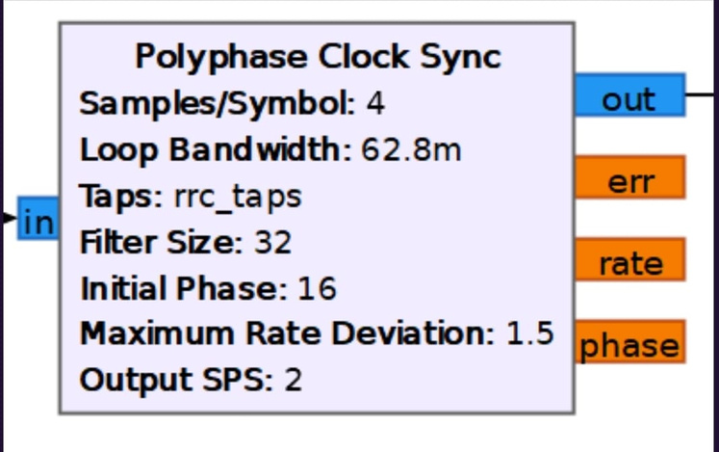
Polyphse clock sync
The polyphase clock sync block in GNU Radio is essential for timing recovery in digital communication systems. It employs a polyphase filter to estimate and adjust the phase offset between the received signal and the local clock.

Slide 17
LInear Equalizer
The linear equalizer block in GNU Radio is employed to counteract the impact of channel distortions on a transmitted signal. It adjusts signal component weights to mitigate amplitude and phase distortions, aiming to restore the original waveform shape.

Slide 18
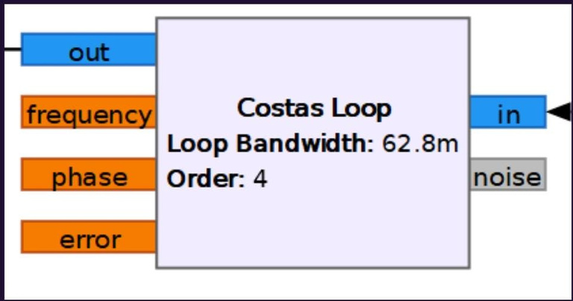
Costas Loop
The Costas loop block in GNU Radio is utilized for carrier phase recovery in digital communication systems, especially for coherent demodulation of PSK signals like QPSK. It estimates and tracks the carrier phase of the received signal.

Slide 19
Constellation Decorder
The constellation decoder block in GNU Radio is essential for demodulating complex modulation schemes like QPSK. It interprets received complex symbols, representing multiple bits each, and converts them back into the original digital data.

Slide 20
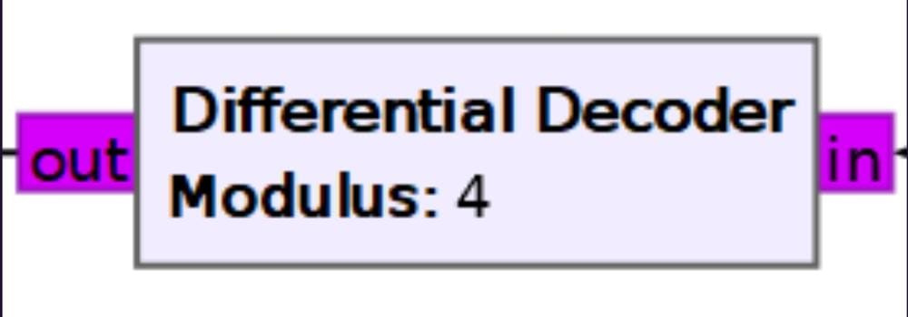
Differential Decorder
The differential decoder block in GNU Radio is employed to reverse the process of differential encoding in digital communication systems. It reconstructs the original symbol sequence from a differentially encoded signal, which is useful when maintaining absolute phase or amplitude information is challenging.

Slide 21
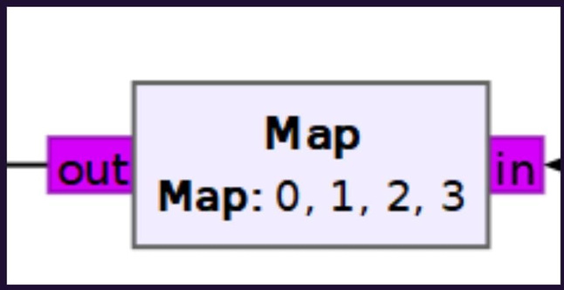
Mapping
Map block refers to a component within a signal processing flowgraph that is used to transform or remap values. It might involve mapping digital symbols to complex points in modulation or reversing this process in decoding. The exact function depends on the specific context within the flowgraph.

Slide 22
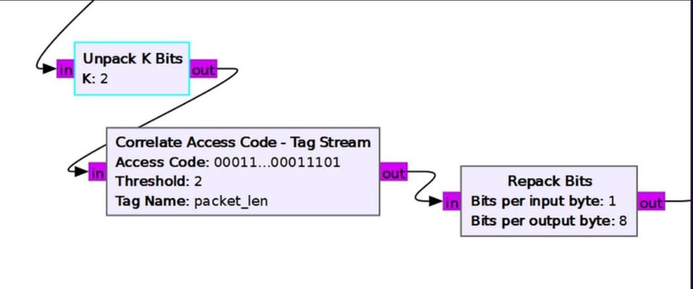
Unpacking
Operations that separate or extract information from a data stream. This often involves using blocks like "Unpack K Bits" to extract specific bits from a byte or stream, particularly useful when dealing with binary data or segmenting signals for further processing.

Slide 23
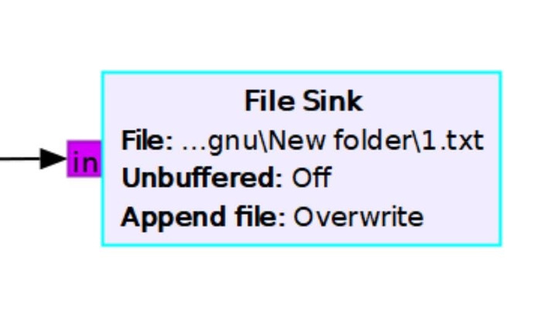
File sink
File Sink block in GNU Radio is used to save processed or demodulated signals from a flowgraph into a file. It serves as an endpoint, facilitating the recording and storage of data for offline analysis or sharing with other systems.

Slide 24
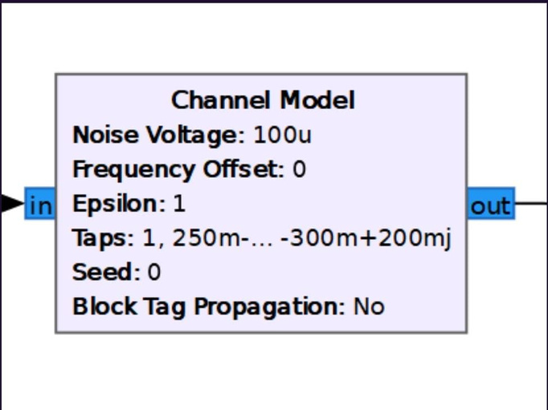
Channel Block
The Channel Model block in GNU Radio simulates the impact of a communication channel by introducing noise, fading, and interference to a signal. It is valuable for testing and evaluating the performance of communication systems under various channel conditions.

Slide 25
Connecting Blade Rf

Slide 26
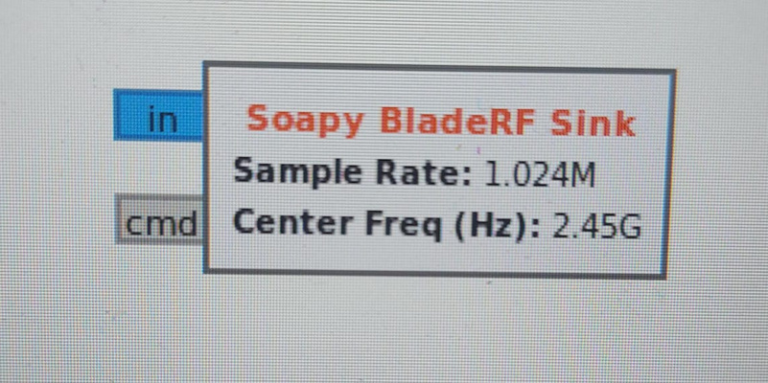
Soapy BladeRf Sink
The SoapyBladeRF Sink block in GNU Radio is used to interface with BladeRF software-defined radios using the SoapySDR API. It enables the transmission of signals generated within a GNU Radio flowgraph to the BladeRF hardware, allowing for configuration and control of BladeRF parameters directly from the flowgraph.

Slide 27
Soapy BladeRf/ RTLSDR Source
The SoapyBladeRF/RTLSDR Source block in GNU Radio is utilized for interfacing with BladeRF and RTLSDR software-defined radios using the SoapySDR API. It enables the reception of signals from the SDR hardware, allowing integration into a GNU Radio flowgraph.

Slide 28
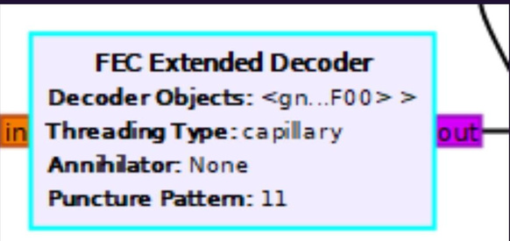
FEC extended encoder/decoder
The FEC Extended Encoder/Decoder block in GNU Radio enhances communication system reliability by adding redundant information to the transmitted signal and correcting errors in the received signal. This ensures more precise and dependable data transfer

Slide 29
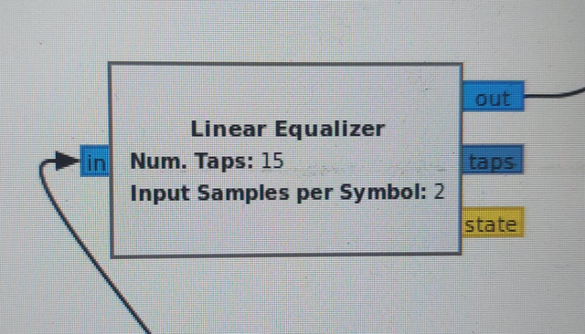
Digital Linear Equalizer
The linear equalizer block in GNU Radio counteracts distortions from a communication channel by adjusting signal component weights, restoring the original shape of the transmitted waveform and aiding in signal recovery.

Slide 30
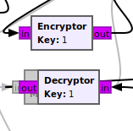
Encrypting and Decrypting
In GNU Radio, encoding blocks transform digital data for transmission, often using schemes like Forward Error Correction (FEC) to enhance error resilience. Decoding blocks reverse this process, recovering the original data from received encoded signals. Together, they ensure accurate and reliable communication in digital systems

Slide 31
End

